Slide 1
TedSquare Ltd HR Recruitment Analysis
By
Kori Numbere
September 2024

Slide 2
Case Content
Objectives of Analysis
Business Problem
Identify the most cost-effective recruitment method for TedSquare Ltd.
Analyse potential benefits, risks, and consequences associated with each method.
Analyse the recruitment cost data to understand the cost associated with each recruitment method.
Consider current global recruitment trends
The HR function of recruitment in TedSquare Ltd is under threats of budget costs.
Needs to optimize operations and reduce recruitment costs.

Slide 3
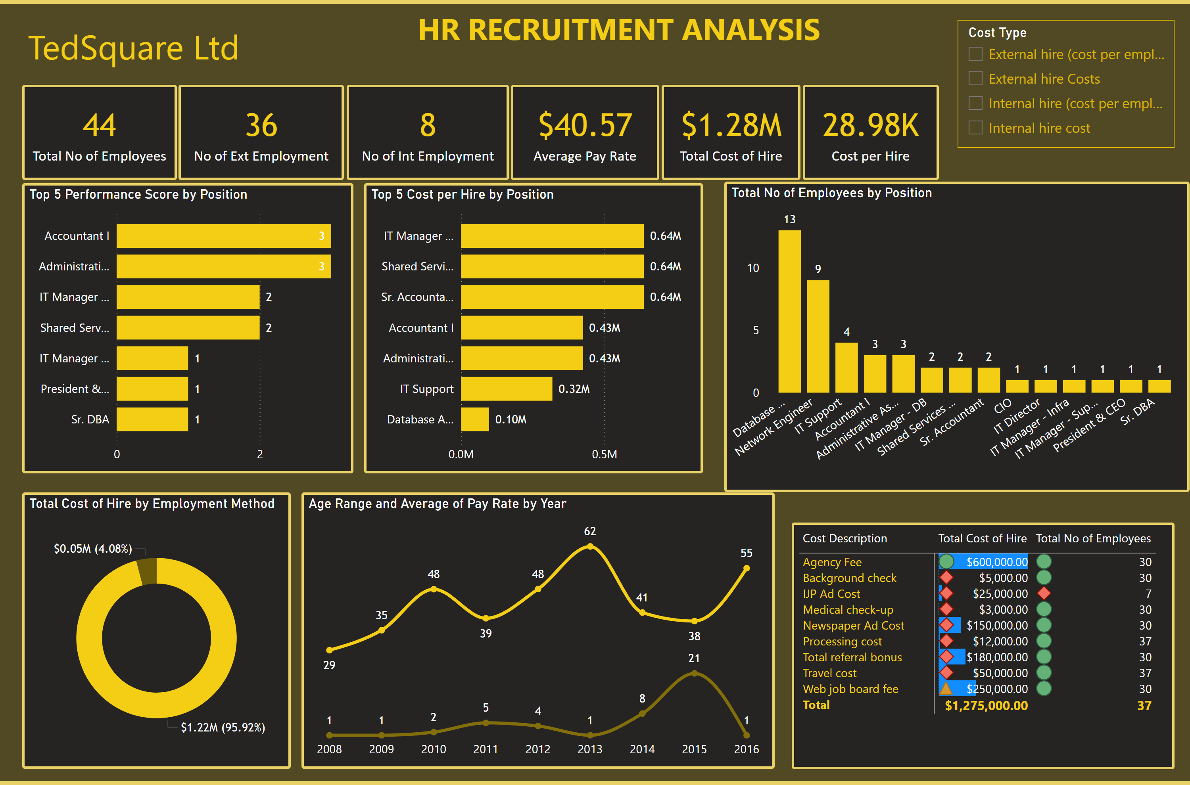
Page 1
Notes:
textbox
No alt text provided
textbox
No alt text provided
lineChart
No alt text provided
clusteredColumnChart
No alt text provided
card
No alt text provided
donutChart
No alt text provided
clusteredBarChart
No alt text provided
pivotTable
No alt text provided
clusteredBarChart
No alt text provided
card
No alt text provided
card
No alt text provided
card
No alt text provided
card
No alt text provided
card
No alt text provided
slicer
No alt text provided

Slide 4
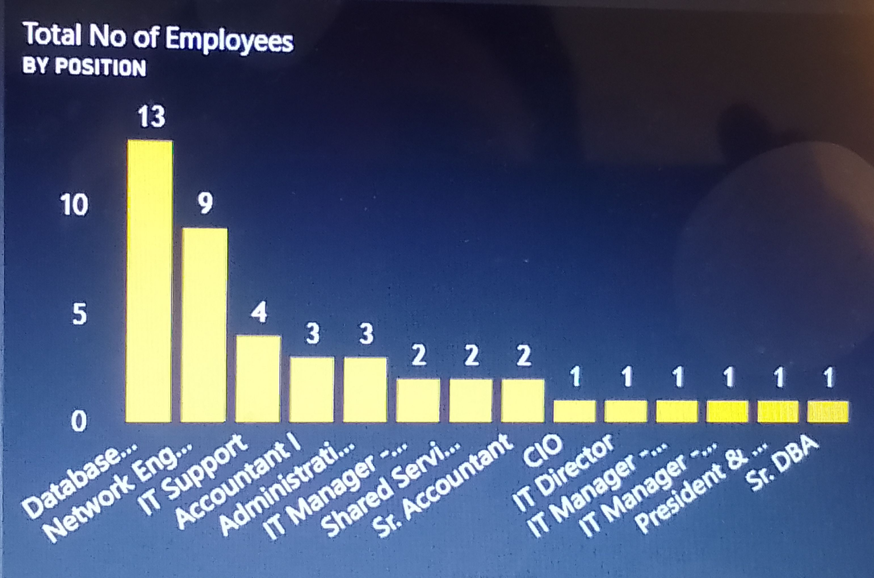
TedSquare Workforce Structure
BI Situation
Workforce Structure -
more database employees (13) = 29.5% of workforce
A Many-to-Many cardinality is seen with the Employment method in the ERD (Entity Relationship Diagram)
This means there are one or more employment methods deployed for recruitment by TedSquare Ltd with cost implications also relating to more than one method of employment method.
This also indicates that the employment methods are not uniquely applicable to TedSquare. So, by considerations of cost implications TedSquare have possibility to adopt the most cost-effective employment method suitable

Slide 5
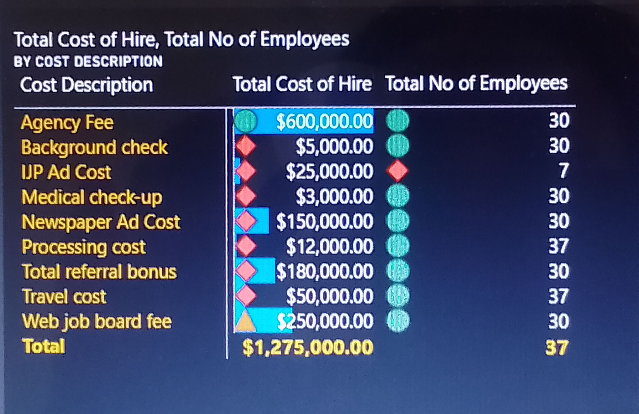
Recruitment Cost Type Analysis
Situation
Cost Type Analysis
The Matrix chart has been used for the cost types analysis using the calculated measures of Total Cost of Hire and Total No. of Employees.
The major insight drawn here is that the top 2 recruitment cost types are Agency and Web Job Board fees
These costs were channelled to recruiting 30 employees, which is about 82% of the current workforce. However, Newspaper Ad is a lesser cost type which also catered to same number
What can HR do to minimize these costs?

Slide 6
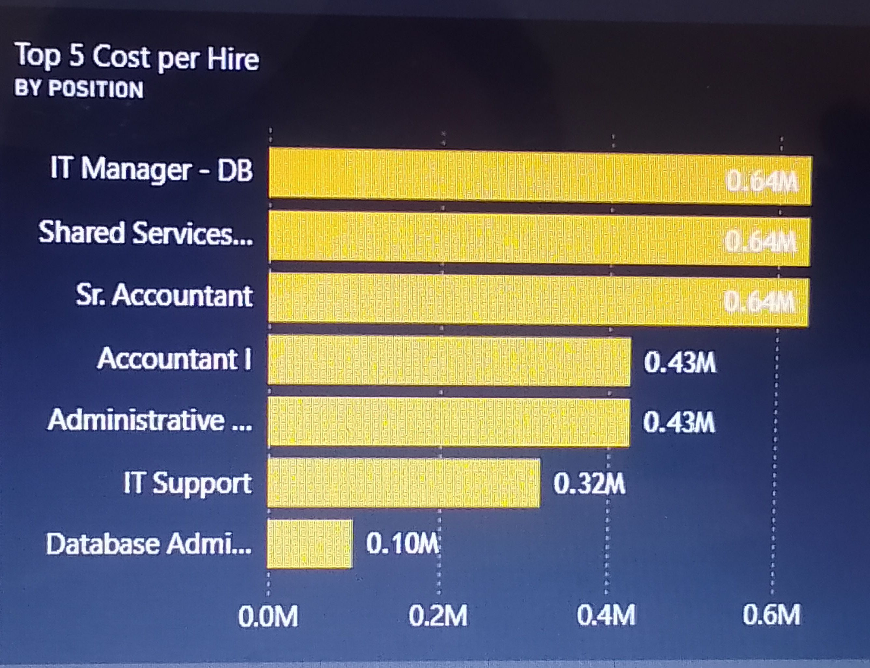
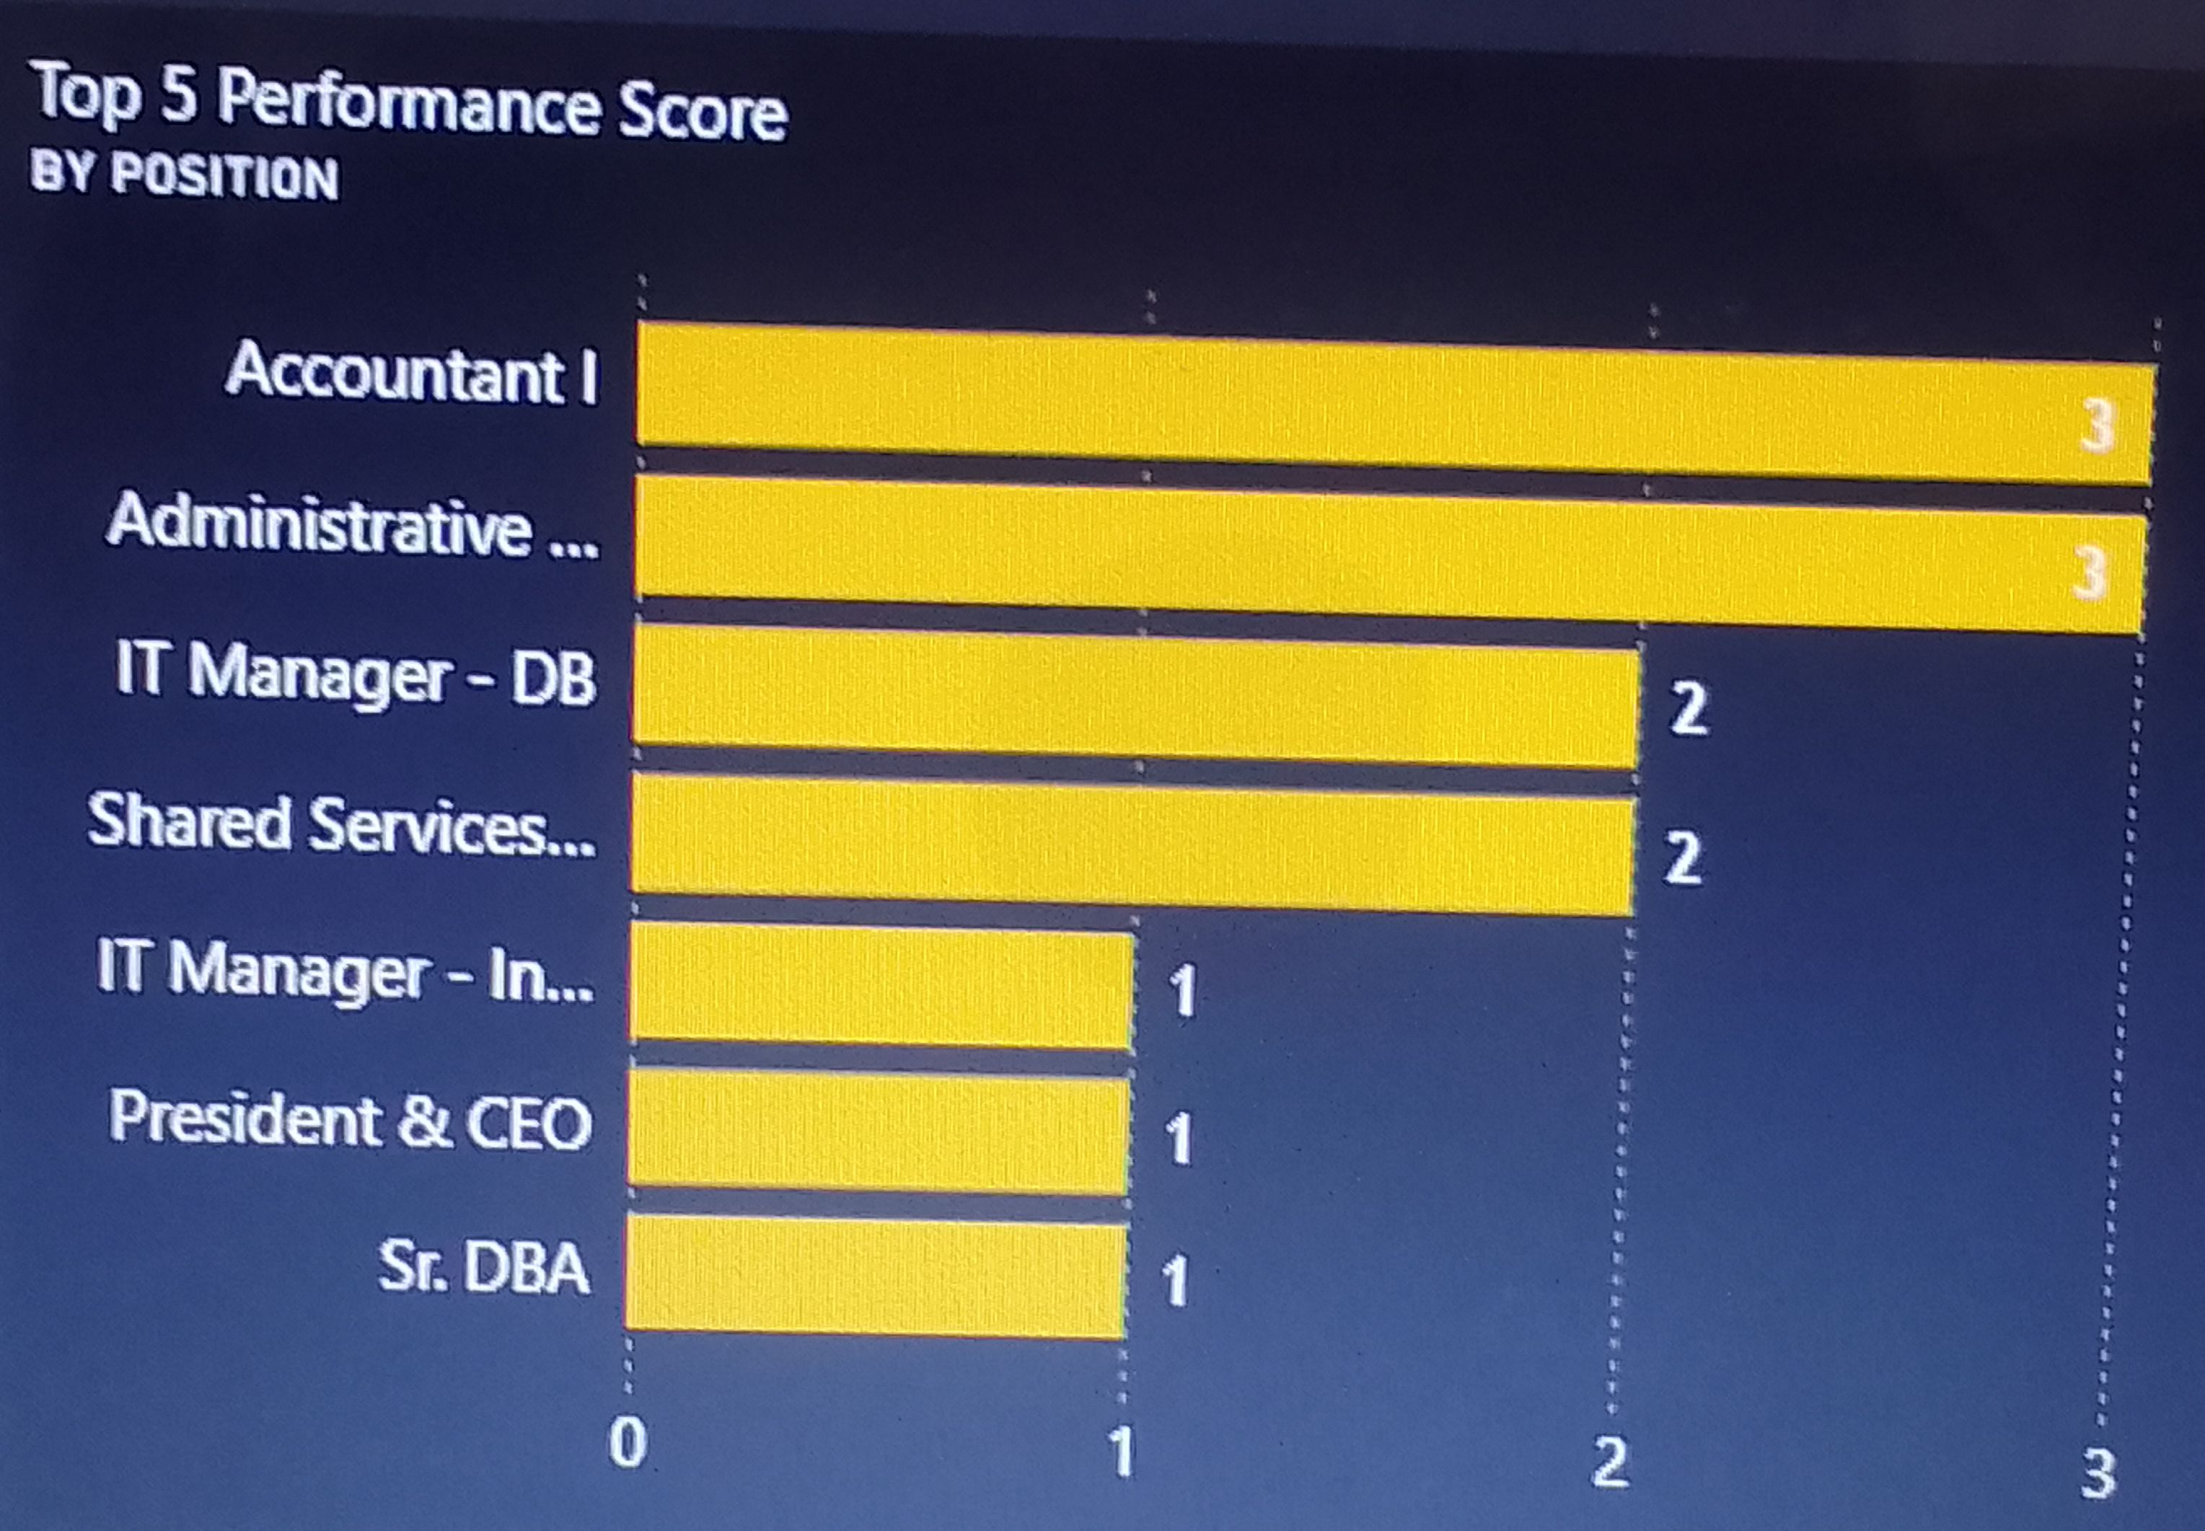
Employee Cost Per Hire / Performance Analysis
Top 5 High Cost per Hire Employees
Top 5 High Performance Employees

Slide 7
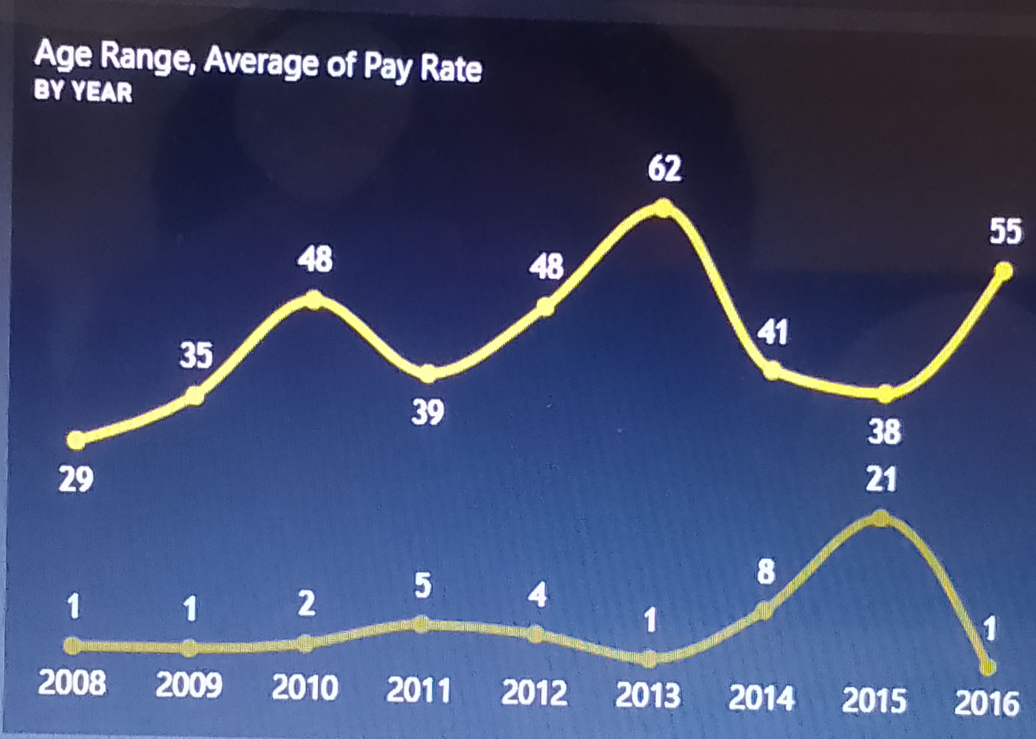
Employee Data Distribution Analysis
Situation:
Employee distribution by age, date (year) of employment, pay rate
In 2008 Young Adults (20-29) (possibly new employees) payrate is $28.5. By 2010, Young Adults now Adults (30-39) earn $48.20 (pay rate progression seen)
By 2013, Young Adults category now have higher payrate of $62.0 ( almost double in 5 years); but by 2016 it drops to $55.0
The lowest for Young Adults is ibtwn 2011 and 2015 - $37.91 which is less than the $38.0 for the Ageing Adults (60 & Above)
What should HR do about the Age metric in aligning with pay rate?

Slide 8
Country (U.S.A) Pay rate Trends (IT industry)
Situation:
Analysis:
Average pay rate in the US is about $24.71 in the upper range.
This also depends on the factors of education level, location, and demographics.
Average pay rate of TedSquare Ltd is $40.57, which is 39.0% higher than the country average
Form this comparison,, the Pay rate analysis shows that more than half of TedSquare employees (26) are High Payrate employees
This double-digit excess of 39.0% can be considered a ‘high payrate if it does not translate effectively to optimum profitability for TedSquare Ltd.

Slide 9
Recruitment Method Analysis
Types of recruitment method used by TedSquare Ltd | Potential benefits | Consequences (Risks) associated with Internal method | Current Global Internal Recruitment Methods | Alternative recruitment method consideration from current global recruitment trends
Internal | Reduce hiring processing time Reduce onboarding costs Save hiring cost in the immediate term Increase employee engagement and reducing performance risks | Limits diversity of talent pool of potential employees Limits talent application pool causing likely talent loss Lack of innovation Inherent skill gaps among internal candidates Limiting office politics and employee burnouts | Social media recruiting Virtual Hiring – AI, Chatbots | Remote recruitment / Hiring

Slide 10
Recruitment Method Analysis cont’d
Types of recruitment method used by TedSquare Ltd | Potential benefits | Consequences (Risks) associated with external method | Current Global External Recruitment Methods | Alternative recruitment method consideration from current global recruitment trends
External | Takes pressure of internal HR Team. Provides a larger selection pool of Candidates. Increases likelihood of more ‘right fits’ Enables fresh perspectives & company diversity Increases attraction for company Increased access to specialized candidates to improve efficiency | May not be budget-wise due to higher costs Time consuming for all stakeholders Takes longer processing times | Diversity Hiring B2B (Business to Business) Contracts | Streamlining Hiring – that reduces no. of recruitment steps, thereby minimizing recruitment costs

Slide 11
Concluding insights
Cost Type Analysis
Employee Distribution Analysis
The resulting cost for each recruitment method is dependent on the costs accrued from specific sources (cost description)
The most cost-beneficial external employment source is the Newspaper Ad ($150,000)
The next best cost-efficient employment source is the internal method of Referral Bonuses ($180,000)
Average payrate of per employee by external method is a higher than total average payrate.
The Accountant and the Administrative Assistant. are the best performing employees
The larger portion of the workforce are Database Admins who are Adults (30-39) – 76.9%. They are low in cost per hire but also lower in performance.
For this reason, HR may be required to look into performance level optimization for Database Admins

Slide 12
Recommendations
Situation:
Recommendation:
Query 1: What can HR do to minimize external recruitment method costs – e.g. Agency & Web Job Fees?
Query 2: What should HR do about the Age metric in aligning with competitive pay rates?
Query: 3 What should HR do about the performance levels for DB Admins?
HR can engage cheaper vendors as Agents and Web hosts for recruitments. Or HR can completely withdraw one of these costs, e.g. :
By hosting and maintaining company recruitment Website in-house
Utilizing Newspaper Ads more
Specialist hires handled by less pricy Agencies
Streamline pay rates by performance-based renumerations in addition to other relevant financial bonuses

